Slide 1
Machine Learning
Introduction to Machine Learning

Slide 2

Module Objectives
After completing this course you will be able to:
Describe what the field of machine learning is about
Contextualize machine learning with respect to artificial intelligence and statistics
Understand what kinds of problems machine learning can efficiently solve
Explain what the challenges for machine learning are
List some of the market players in machine learning and the tools they provide

Slide 3
Meet & Greet
Let’s get to know each other! Tell us:
Who you are?
University?
Previous Experiences?
Hobbies?
If you ever were the first person to meet a previously uncontacted tribe…

Slide 4
A Short History of Machine Learning
<1950 Prehistory of machine learning (aka “statistics”)
1950 Alan Turing started the quest for thinking machines
1959 Arthur Samuel first coined the term “machine learning”
1980’s The rediscovery of backpropagation causes a resurgence
in machine learning research
1990’s The focus shifts from knowledge-driven to data-driven
2000’s The sudden availability of huge volumes of data drastically
expanded the number of applications for machine learning
2010’s Deep learning becomes feasible, which leads to the widespread
use of machine learning in services and applications

Slide 5
What is Machine Learning?
Tom M. Mitchell provided the following formal definition of computer programs
that can learn:
A computer program is said to learn from experience E with respect to some class of tasks T and performance measure P if its performance at tasks in T, as measured by P, improves with experience E.

Slide 6
What is Machine Learning?
Still trying to wrap your head around that definition?

Slide 7
What is Machine Learning?
Still trying to wrap your head around that definition?
Here’s a more accessible one:
Machine learning allows us to take existing data, analyse it to identify patterns and use the results to make better predictions about new data.
Sounds better?
What? Still unclear how those steps are carried out?
No worries, we will delve into each of them in this course.

Slide 8



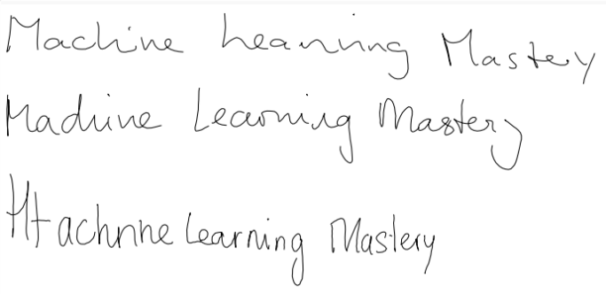

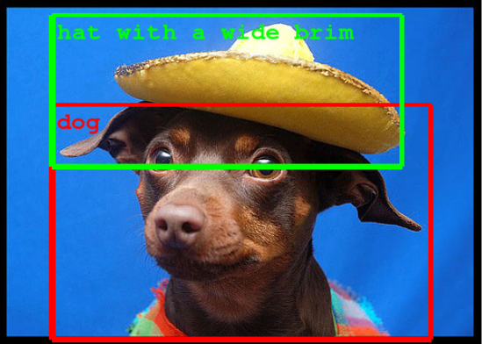
ML Applications: The Visual and Inspiring!
Image generation (intermediate phase)
Image Colorization
Image translation
Text Generation (from Shakespeare)
Object classification
and detection
Handwriting Generation
Notes:
Links:
https://machinelearningmastery.com/inspirational-applications-deep-learning/
https://ai.googleblog.com/2015/06/inceptionism-going-deeper-into-neural.html

Slide 9
ML Applications: The Down To Earth
Those examples were all very cool, but … how can ML help ordinary companies?

Slide 10
ML Applications: The Down To Earth
Those examples were all very cool, but … how can ML help ordinary companies?
Here are some questions that ML can help you answer:
What’s the best price
to sell a product?
How often should we send
marketing emails?
Should we segment them by category?
How likely is it that this customer will renew their subscription?
What should those categories be?
Do people say good or bad things about us online?
What can we do to keep them here?
What Offer? What Promotion?
Does it even matter?
Offers? Promotions?
In business applications, ML is also referred to as predictive analytics

Slide 11
Machine Learning and Artificial Intelligence
Broadly speaking, AI encompasses any cognitive ability a machine may possess:
Artificial Intelligence
Computer programs that are
capable of following a set of
provided explicit rules
Machine Learning
Computer programs that
learn from examples
ML is used whenever conventional algorithms are not able to effectively perform a task

Slide 12
Exercise 1
List 3 practical problems where a conventional programming solution works best
List 3 practical problems where machine learning works best
Duration - 15 minutes.
Discussion & Feedback.

Slide 13
Machine Learning and Statistics
Machine learning and Statistics are actually much closer than many people would think
Statistics is a branch of mathematics dealing with the collection, analysis, interpretation and presentation of masses of numerical data.
Sounds a lot like what machine learning is concerned about … so, what’s the difference?
Argument 1: statistics focuses on inference; machine learning on prediction
Isn’t prediction just one instance application of inference?
Can’t the same techniques be applied in both cases?
Argument 2: statistics is concerned with theory; machine learning with application
False: statistics applies inference to medicine, demographics, etc …;
and many ML algorithms “rediscovered” old statistical methods
But … true: ML broadens the scope of application of statistical inference
by making creative use of new computing architectures
Notes:
Definition of “statistics”:
https://www.merriam-webster.com/dictionary/statistics
A very interesting read on the relation between ML and stats, where Michael I. Jordan proposes the use of the term “data science” as a placeholder for the overall field:
https://www.reddit.com/r/MachineLearning/comments/2fxi6v/ama_michael_i_jordan/ckelmtt/?context=3
Another one on the relationship between ML and stats:
https://www.ncbi.nlm.nih.gov/pmc/articles/PMC6082636/

Slide 14
Exercise 2
Find a problem that has been solved by both machine learning and statistical techniques
How do the two solution differ? How are they similar?
Duration - 15 minutes.
Discussion & Feedback.

Slide 15
Causes for Concern
Privacy Issues
Malicious actors having access to personal and/or sensitive information
Voter targeting campaigns and implications for democracy
Common good sacrificed in the name of profits
Algorithmic Bias
Biases reinforced in criminal risk assessment systems
Spread of hate speech and fake news
Biased search engine results
Safety Issues
Self-driving cars
Any ML algorithm applied to critical tasks

Slide 16

The Devil Is In The Data
Consider a streaming platform’s recommendation system:
update recommendations
update recommendations
Popular
videos
list
Personal
recomm.
list
Recommendation
engine
watch video
How often do you get recommendations that you aren’t currently interested in?
What if the system had to choose whether to admit a University candidate, or
to assess the likelihood of recidivism of a convicted felon?
Objective data and criteria selection are extremely important

Slide 17
Addressing Concerns
Algorithmic processes have a great impact on individuals and society at large
Critiques are fair and should be listened to
But ML is simply a tool
It is neither inherently good nor inherently bad
Arguably, any radical change in society or technology is driven by profitability
Concerns should be seen as an opportunity for a more nuanced conversation
Ways to address issues include regulations
Experts from various fields should be consulted (sociology, law, …)

Slide 18
Exercise 3
Group presentation on a critical application for automated decision making
Duration – Afternoon Session.
5 – 6 slides – 10-15 minute presentations
Topics decided beforehand and distinct for each group
Describe application
Describe challenges
How were challenges solved to reach accurate/ fair decisions?
State your sources (research papers, online articles, wikis, …)
16

Slide 19









Market Players and Tools
Frameworks / Tools
17
Notes:
19
Tools:
Microsoft Azure Machine Learning
Amazon Web Services (AWS) Machine Learning
IBM’s Watson Machine Learning
Google Cloud Machine Learning Engine;
Google Brain’s Tensor Flow
Apache: Mahout; Spark; MXNet
SciKit Learn
Torch / PyTorch
…

Slide 20
Module Review
What is machine learning and what does it do?
What is the relationship between machine learning and artificial intelligence?
What is the relationship between machine learning and statistics?
How can machine learning help ordinary companies?
What do critics of machine learning say?
How can we overcome the challenges?

Slide 21
Module Outcomes
You should be able to:
Understand what machine learning is
Compare machine learning with conventional programming
Compare machine learning with other fields
Understand the typical questions machine learning can answer
Understand some of the best practices to ensure fair and accurate results

Slide 22
Questions

